Slide 1
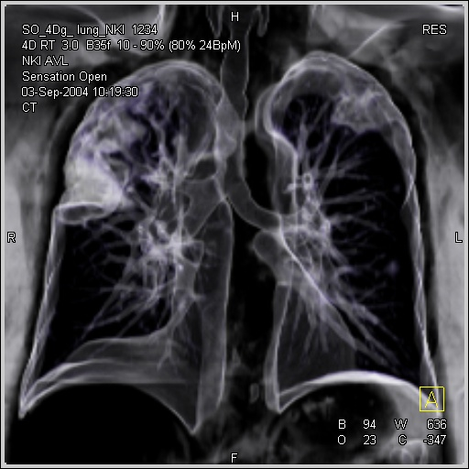

Asservissement respiratoire et Radiothérapie
Pr Philippe Giraud
Service d’Oncologie Radiothérapie
Hôpital Européen Georges Pompidou, Paris

Slide 2
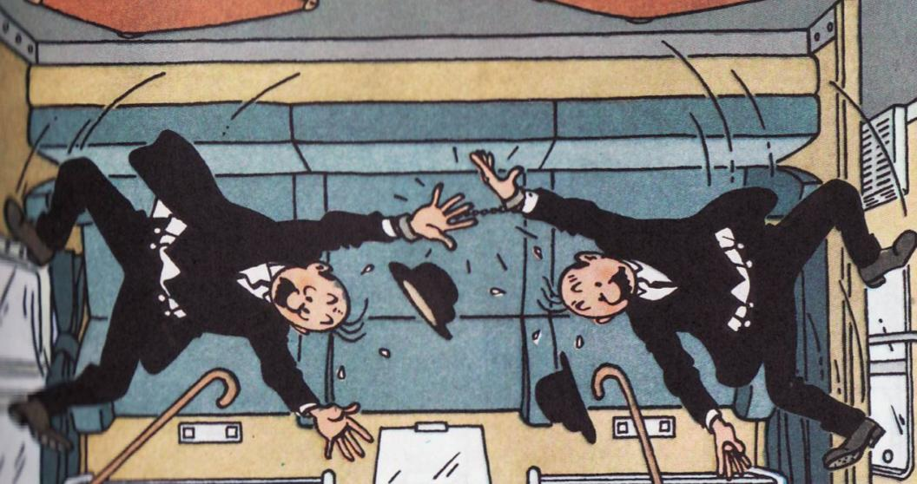
Le Dilemme :
Contrôle local vs Complications
CBNPC : Dose ≥ 66 Gy
CBPC : Dose ≥ 60 Gy (66 Gy)
Poumon ≈ 20 Gy
Cœur ≈ 35-40 Gy

Slide 3
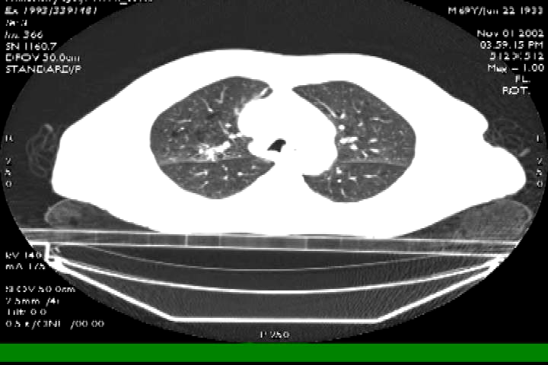
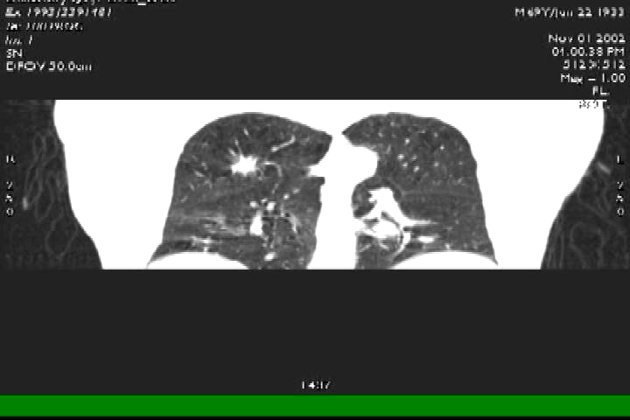
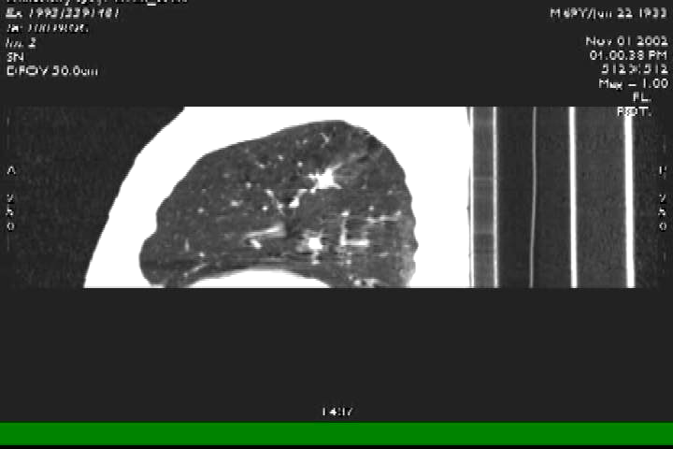
Importance des mouvements respiratoires
Courtesy of Gig Mageras, Ken Rosenzweig,
Ellen Yorke - MSKCC

Slide 4
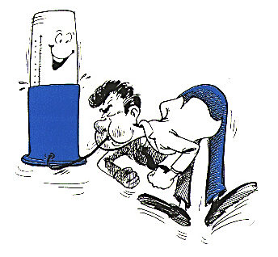
EFR : Quelles limites ?
VEMS > 40% de la théorique
DLCO > 40 ou 60% de la théorique
PaO₂ > 60 mm Hg

Slide 5
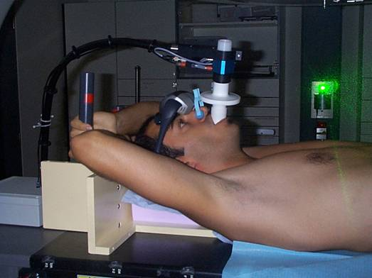

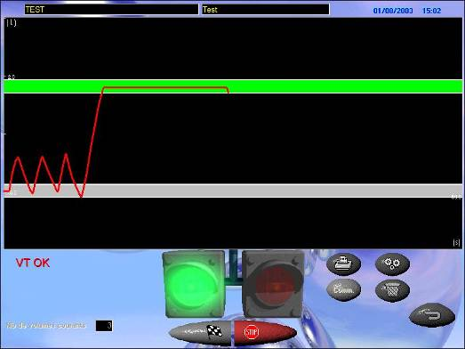
Blocage volontaire : Dyn’ R

Slide 6
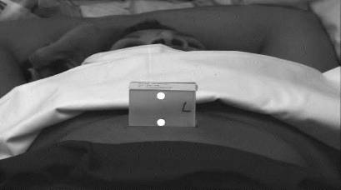
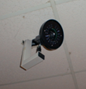
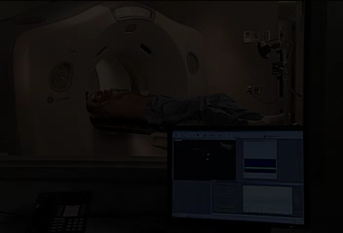
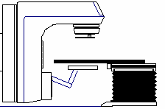

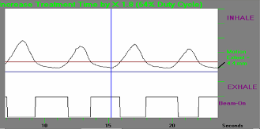
Acquisition 4D
Marqueurs
On/Off
Contrôle
accélérateurs
Notes:
The system consists of a mobile computer equipped with real-time digital video acquisition and display, gating software and user interface, a charge-coupled-device (CCD) video camera with an attached infrared illuminator, and a linear accelerator gating interface for beam on-off control. To monitor respiration, a lightweight block containing two passive reflective markers is placed on the patient’s chest or abdomen. Infrared light from an illuminator is reflected from the markers and detected by the CCD camera. The video signal from the camera is processed by a software application running on an Intel-based computer.

Slide 7
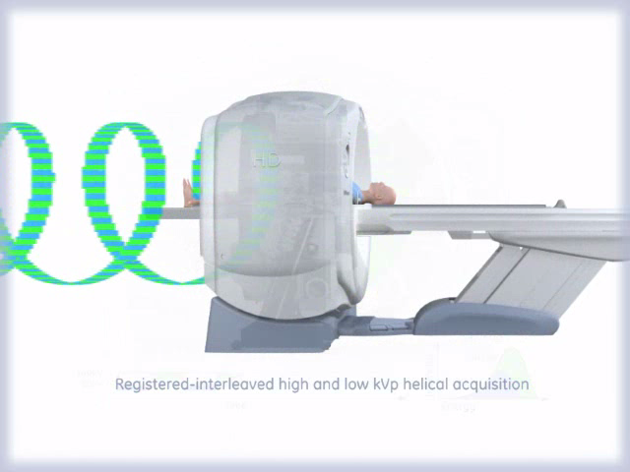
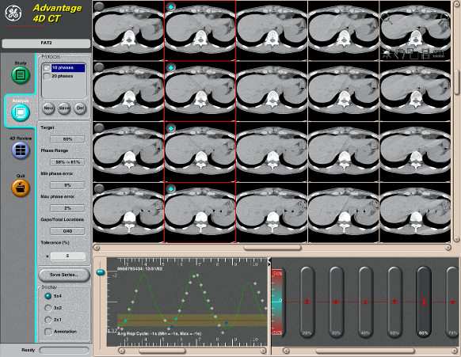






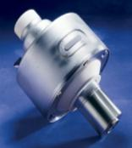


Retrospective Gating
4D CT Image Acquisition
Inspiration max
Expiration max
Inspiration 1…
Expiration 2…

Slide 8
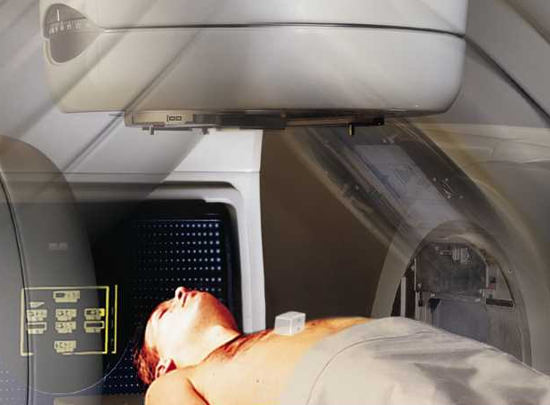
Gated CT for Un-Gated Treatment
1
1
Inhalation
5
2
4
3
Exhalation
5
ITV4D
4
1
3
2
Draw target volume with precise motion information
Treatment has increased likelihood to include the target during dose delivery
Notes:
So what is ROI ?
ROI is simply the total counts per sec divided by 15mCi.
If a subject is injected with 15mCi, what is the total NECR that can be measured on a PET-CT system.
The scientific units for ROI = cps/mCi.
Remember that, according to NEMA Nu-2 2000 & ACR clinical standard, human intravenous FDG dose range for clinical imaging is between 5-20mCi.
So what is the clinical benefit of ROI… higher the ROI means higher the PET-CT system sensitivity, which
Will define the image quality and throughput of a PET-CT scanner.
In 2001 there were 30 million MR procedures performed globally …84% of those were in the “core” areas of brain, spine and orthopedic imaging … These procedures are growing at between 11 and 19% annually.
“Emerging” applications, such as Cardiovascular, Body, and fMRI are growing significantly faster – at 30 to 50% per year.
These growth rates lead to a doubling of MR procedures over the next 4 years, to about 60 million. But, more interestingly, we see a shift in the mix of the procedures, with today’s traditional core applications representing only 70% of the total … and the balance moving towards the emerging applications.
With this shift to the emerging applications, techniques like 3D, time-resolved imaging & parallel imaging techniques will increase which will increase and drive larger data sets per procedure.

Slide 9
Gated CT for Gated Treatment
Inhalation
1
1
5
2
4
3
Exhalation
5
4
1
3
Define Treatment Threshold
2
Notes:
So what is ROI ?
ROI is simply the total counts per sec divided by 15mCi.
If a subject is injected with 15mCi, what is the total NECR that can be measured on a PET-CT system.
The scientific units for ROI = cps/mCi.
Remember that, according to NEMA Nu-2 2000 & ACR clinical standard, human intravenous FDG dose range for clinical imaging is between 5-20mCi.
So what is the clinical benefit of ROI… higher the ROI means higher the PET-CT system sensitivity, which
Will define the image quality and throughput of a PET-CT scanner.
In 2001 there were 30 million MR procedures performed globally …84% of those were in the “core” areas of brain, spine and orthopedic imaging … These procedures are growing at between 11 and 19% annually.
“Emerging” applications, such as Cardiovascular, Body, and fMRI are growing significantly faster – at 30 to 50% per year.
These growth rates lead to a doubling of MR procedures over the next 4 years, to about 60 million. But, more interestingly, we see a shift in the mix of the procedures, with today’s traditional core applications representing only 70% of the total … and the balance moving towards the emerging applications.
With this shift to the emerging applications, techniques like 3D, time-resolved imaging & parallel imaging techniques will increase which will increase and drive larger data sets per procedure.

Slide 10
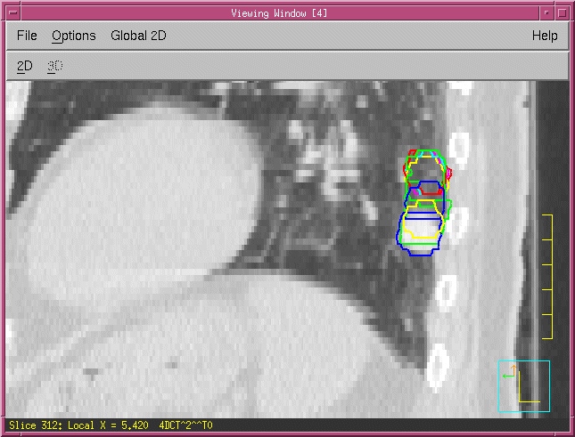
Mode de suivi respiratoire
Gating SBRT
Tracking SBRT
TUMOR
TUMOR
Subclinical Disease
Subclinical Disease
Notes:
This slide shows a comparison of the amount of normal tissue that can be minimized when treating with Synchrony

Slide 11
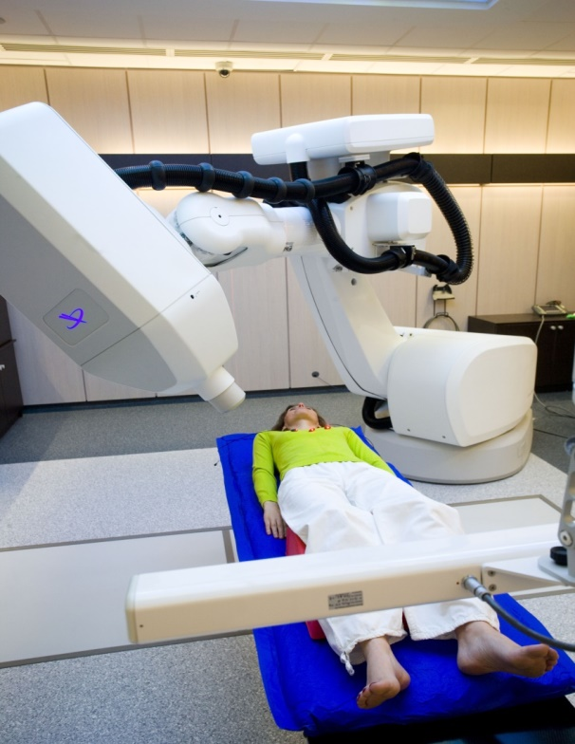

Tracking Respiratoire
Cyberknife™

Slide 12
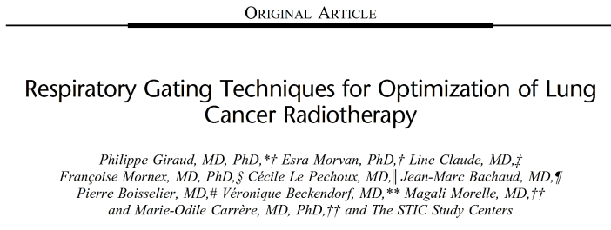

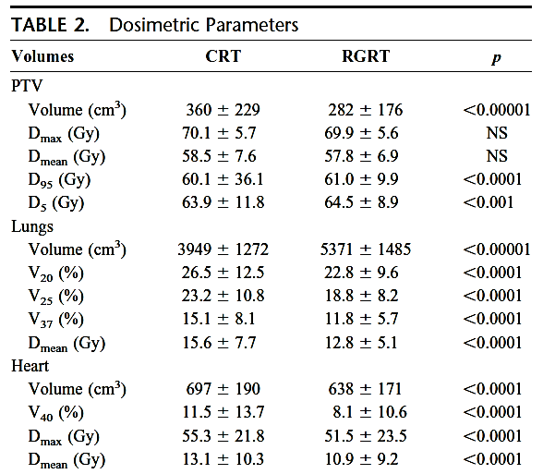
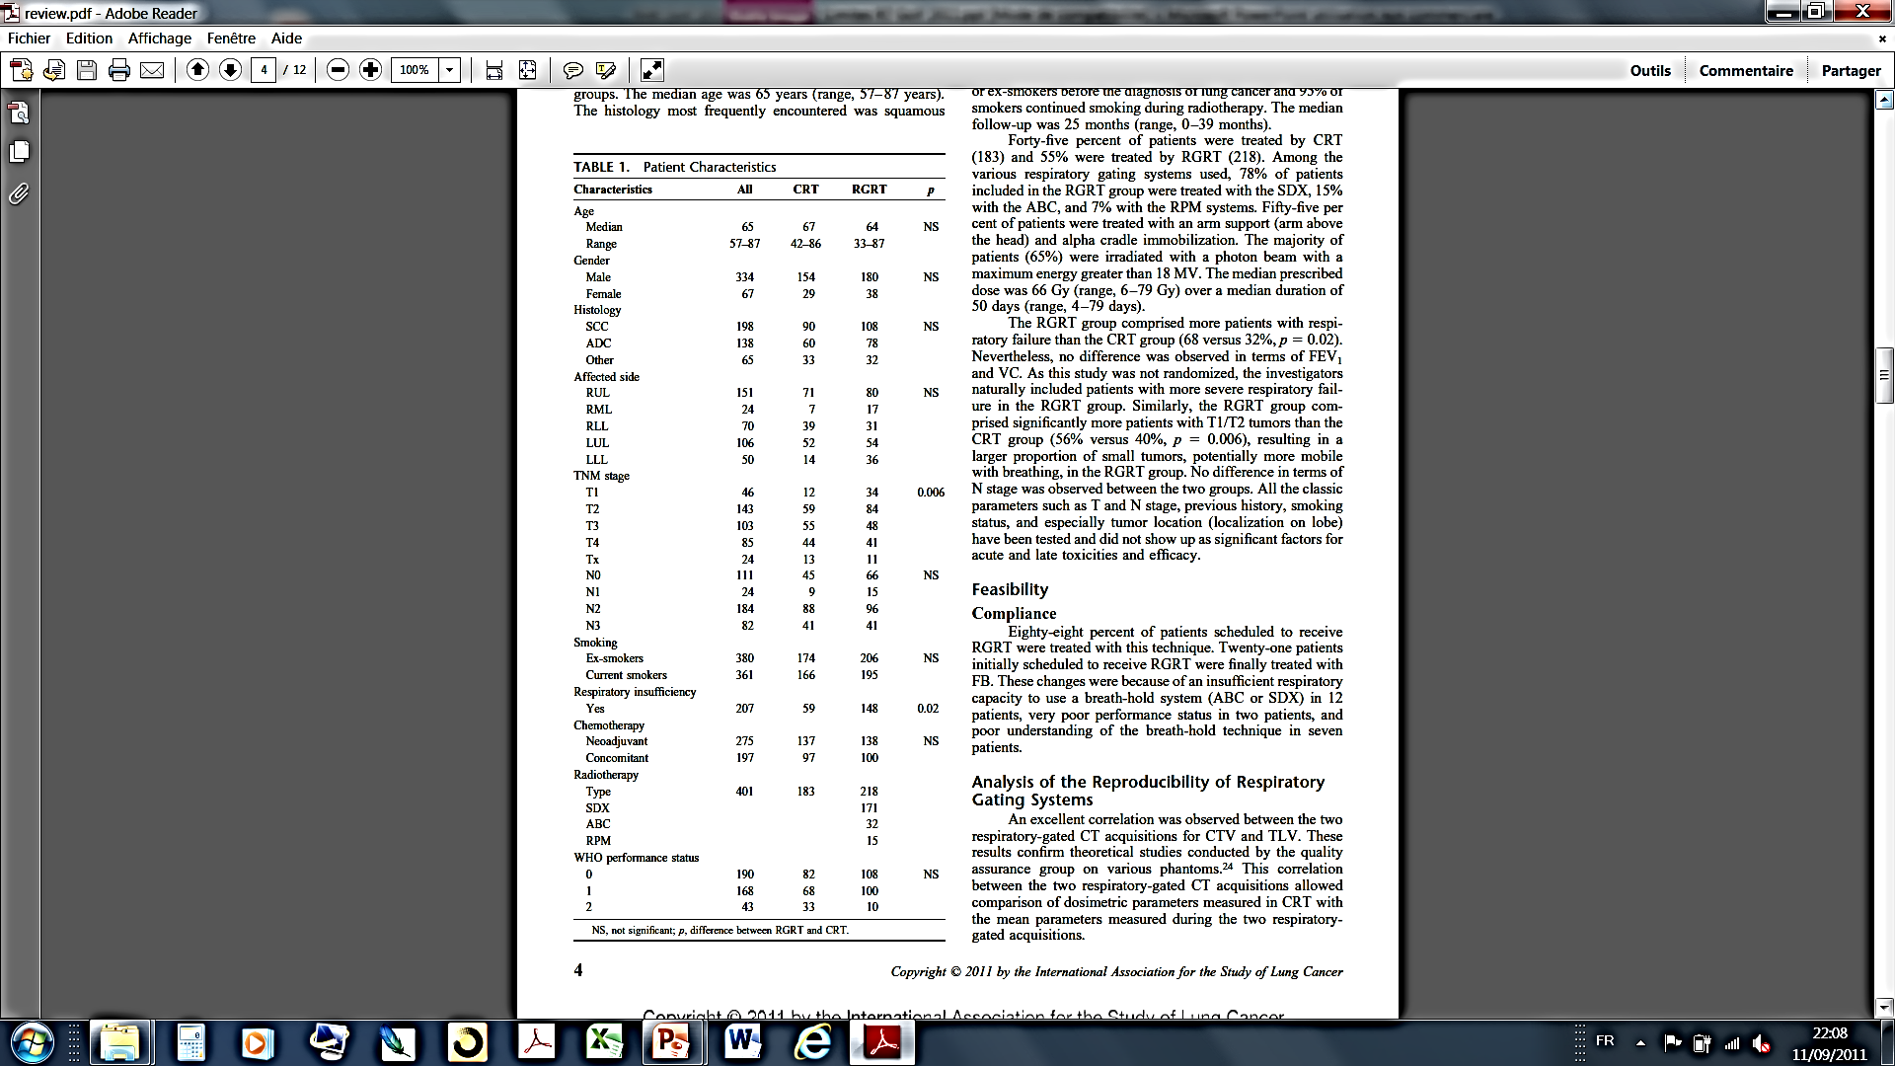
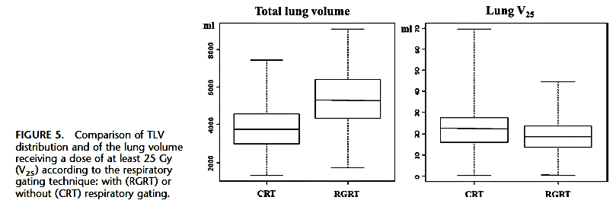
Tox Pulmonaires cliniques :
    à 6 mois : 95% RTC vs 85% RAR, (p<0,05) [G≥3 : 28,4 vs 20,4%]
    EFR à 24 mois : DLCO (-66% RTC vs -17% RAR)
      VEMS (-13% RTC vs -3,6% RAR)
            CV (-16,8% RTC vs -4,4% RAR)
Giraud P. et al. JTO 2011;6(12):2058-68.

Slide 13


